Slide 1
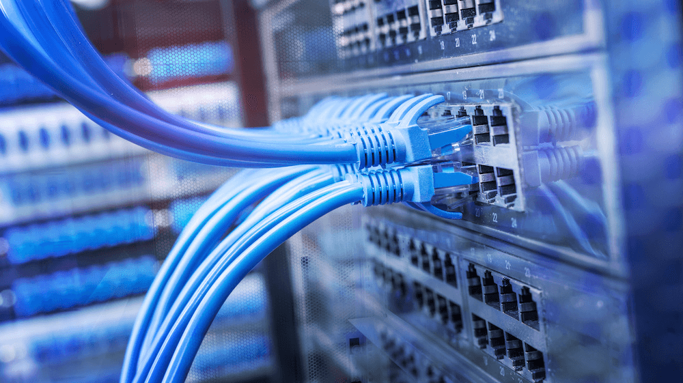
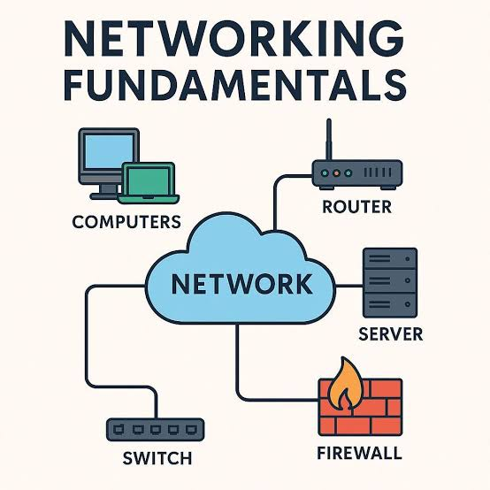
Networking And OS Fundamentals 11.0

Slide 2
Networking Fundamentals
Networking fundamentals means learning the basic concepts of how computers and devices communicate with each other.
For example: Sharing files between computers
Connecting devices in a network
What is Network:
A computer network is a system of interconnected computing devices that communicate with each other to share data, resources, and services.
How Networks Work
Nodes: Devices like computers, phones, or printers that send and receive data.
Links: Connections that can be wired (cables) or wireless (Wi-Fi).
Protocols: Standard rules that control how data moves across the network.
Hardware: Devices like routers and switches that direct traffic to the right place

Slide 3
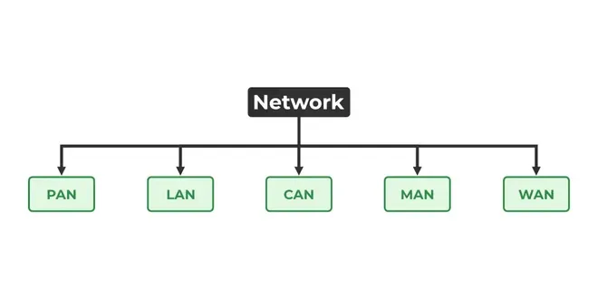
Types of Network
PAN (Personal Area Network): Your Desk. Just reaching devices on your body or table (like Bluetooth).
LAN (Local): Your House. Connecting devices inside one building.
CAN (Campus): Your School. Connecting a few buildings grouped together.
MAN (Metropolitan): Your City. Connecting an entire town or municipality.
WAN (Wide): The World. Connecting different countries; this is the internet.

Slide 4
IP Addressing
An IP address is a unique address given to a device on a network.
Example:192.168.0.10
Public and private IP addresses
Static and dynamic IP addresses
Subnet mask
Default gateway
Basic subnetting
Simple example: An IP address is like the home address of a computer on a network.
DNS Fundamentals
Domain Name System
What DNS is: DNS is like the Contacts list on your phone
How DNS works: DNS works like the contacts list of the Internet—it converts names into addresses
Domain names: DNS looks up the name to find the right number so your browser knows where to go.
You type: www.google.com
↓
DNS
↓
IP Address
↓
Google's server

Slide 5
HTTP/HTTPS Protocols
HTTP = Hypertext Transfer Protocol
HTTPS = Hypertext Transfer Protocol Secure
They are used when your browser communicates with websites.
HTTP: Data is not encrypted.
HTTPS: Data is encrypted and more secure.
Example: When you open a website such as https://example.com,your brower uses
HTTPS to communicate securely with the website.

Slide 6
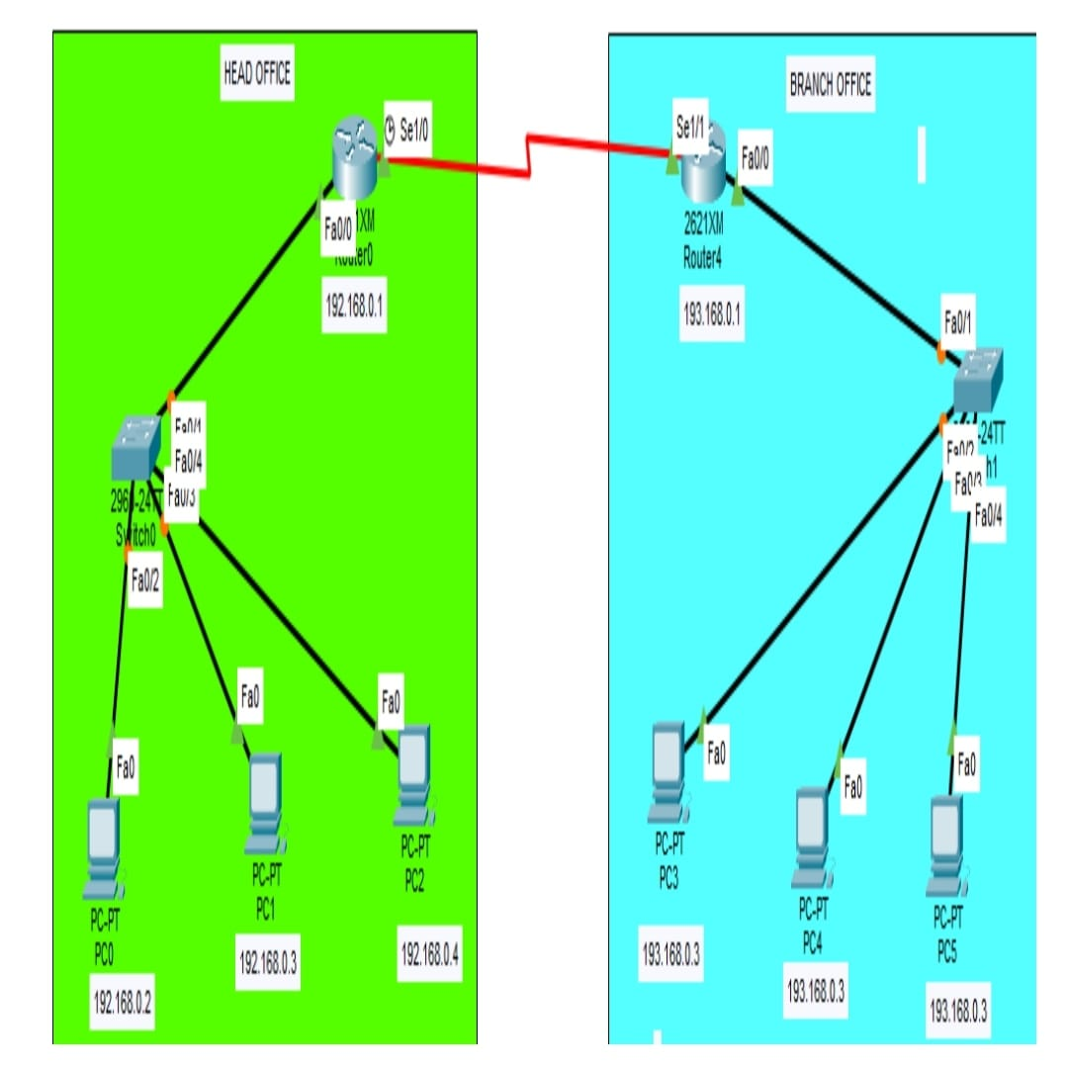
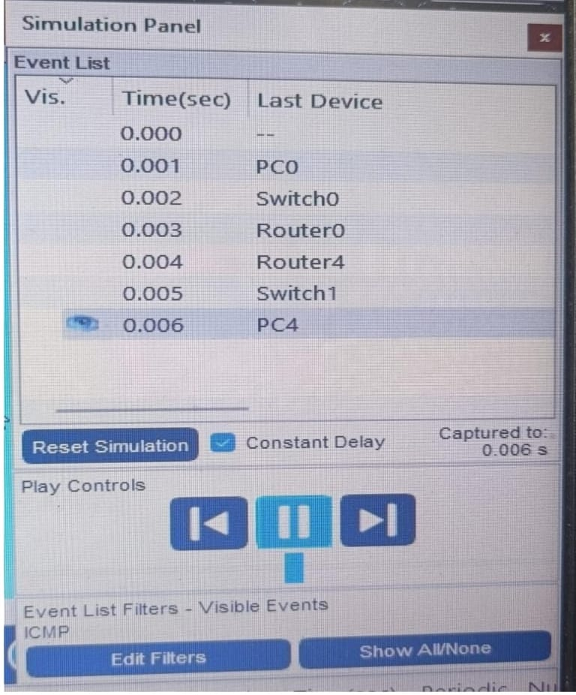
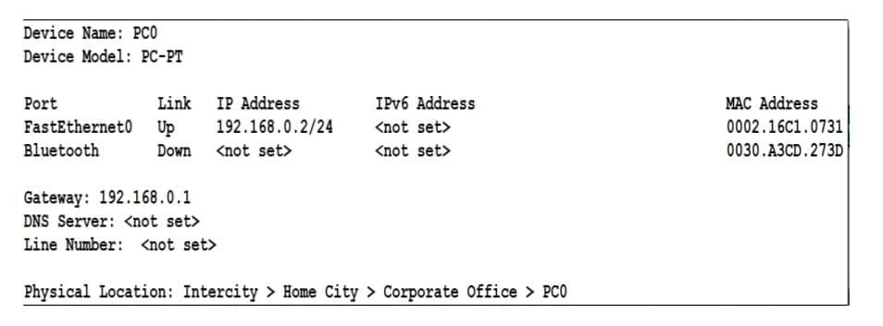
Complete Network and Topology Using Packet Tracer
  This means creating a complete computer network in Cisco Packet Tracer and checking whether all devices can communicate properly.
  Simple Example Simulation Panel
  \
  Network configuration
  summaries PC0 .

Slide 7
Core Internet Technologies
What are Internet Technologies?
Internet technologies are the rules and systems that help computers and devices communicate with each other.
They help us:Send and receive data
Access websites
Send emails
Share files
Connect to different networks
Protocol Concepts
A protocol is a set of rules used for communication between devices.
Some common protocols are: HTTP/HTTPS – used for websites
FTP – used for file transfer
DNS – converts domain names into IP addresses
TCP – provides reliable communication
IP – helps deliver data to the correct device
Example: When we open a website, different protocols work together to load the webpage

Slide 8
OSI Model
Open Systems Interconnection
The OSI Model explains how data moves through a network.
OSI Model – Simple Example Table
Layer No. | OSI Layer | Example | What it does
7 | Application | HTTP, HTTPS, FTP | Provides network services to applications
6 | Presentation | Encryption, JPEG, SSL/TLS | Converts, encrypts, and formats data
5 | Session | Session management | Establishes and manages communication sessions
4 | Transport | TCP, UDP | Provides end-to-end data delivery
3 | Network | IP, Router | Finds the route for data packets
2 | Data Link | Ethernet, Wi-Fi, MAC | Transfers frames between devices on a local network
1 | Physical | Cable, Fiber, Radio waves | Transmits data as bits/signals

Slide 9
TCP/IP Model
Transmission Control Protocol = Makes sure all packets reach correctly.
Internet Protocol = Helps find where the packets need to go.
TCP/IP Model – 4 Layers
Layer No. | TCP/IP Layer | Examples | Main Function
4 | Application | HTTP, HTTPS, FTP, DNS | Provides services to applications
3 | Transport | TCP, UDP | Provides end-to-end communication
2 | Internet | IP, ICMP | Routes packets between networks
1 | Network Access | Ethernet, Wi-Fi | Transfers data through the physical network

Slide 10
Ports and Services
.
These are network ports. A port is like a numbered door on a computer that helps network traffic reach the correct service.
Port | Service | Full Form | What it is used for
80 | HTTP | HyperText Transfer Protocol | Opening normal websites
443 | HTTPS | HyperText Transfer Protocol Secure | Opening secure/encrypted websites
21 | FTP | File Transfer Protocol | Transferring files
22 | SSH | Secure Shell | Secure remote login/access
53 | DNS | Domain Name System | Converts website names into IP addresses
Example: HTTPS normally uses port 443 for secure web communication.

Slide 11
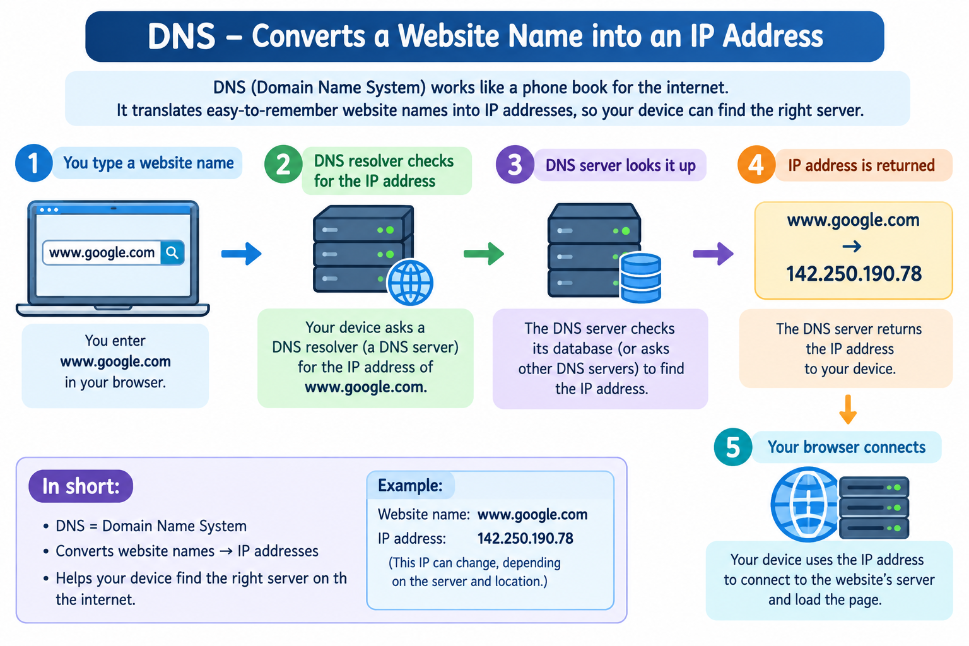
DNS
DNS means Domain Name System.
DNS converts a website name into an IP address.
Example: www.google.com → IP Address
This makes it easier for people to access
websites without remembering
complicated IP addresses.
Secure Web Communication
Secure web communication protects information while using the Internet.
HTTPS is used to secure websites.
It helps protect: Passwords
Personal information
Login details
Online transactions

Slide 12
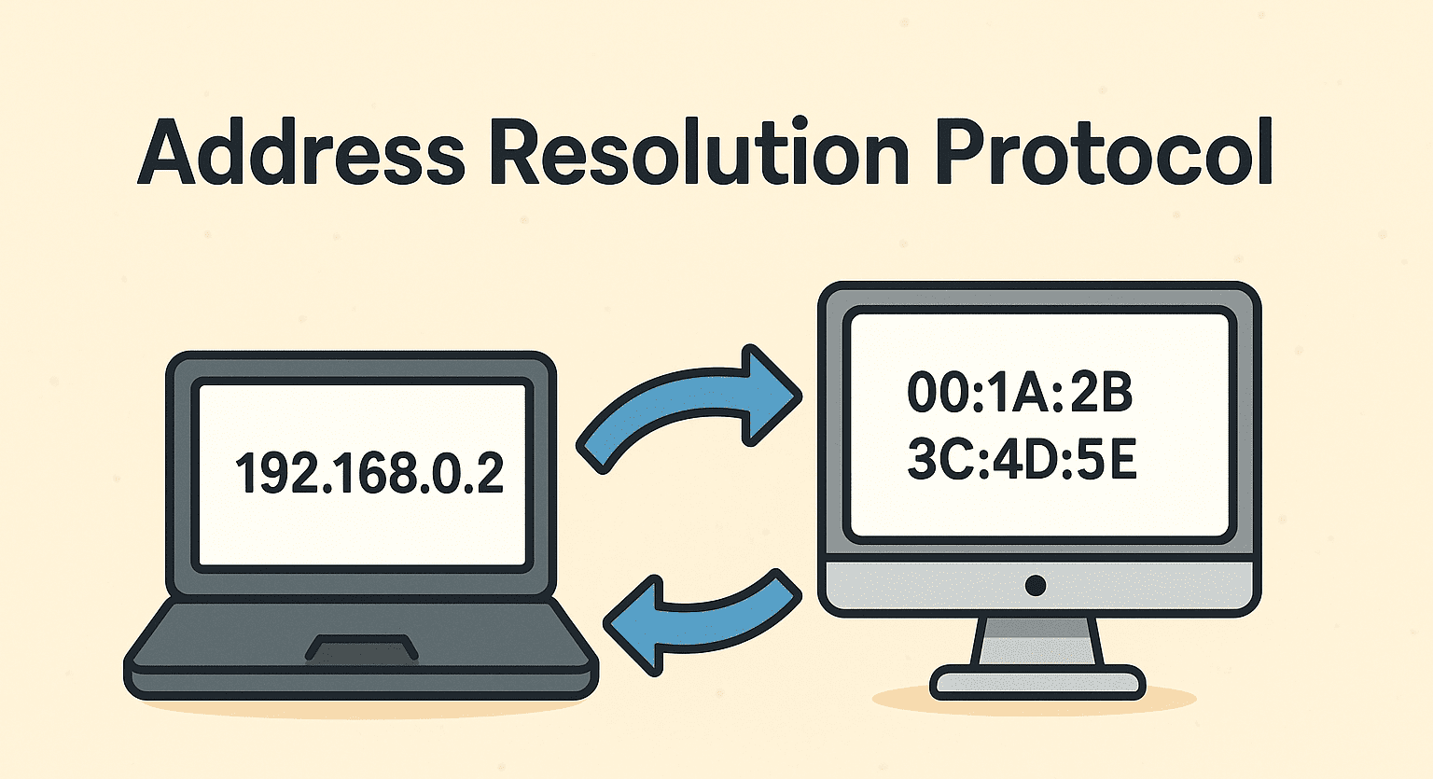
Network Routing & Communication
Routing means finding the best path for data to travel from one network to another.
Example: Your computer → Router → Internet → Web Server
ARP — Address Resolution Protocol
ARP finds the MAC address of a device when its IP address is known.
Example: IP address: 192.168.1.10 → ARP finds its MAC address.
Easy line:👉 ARP = IP address → MAC address
How it work?
The Address Resolution Protocol (ARP) matches a device's logical IP address to its physical MAC address so data can reach the correct destination on a local network.

Slide 13
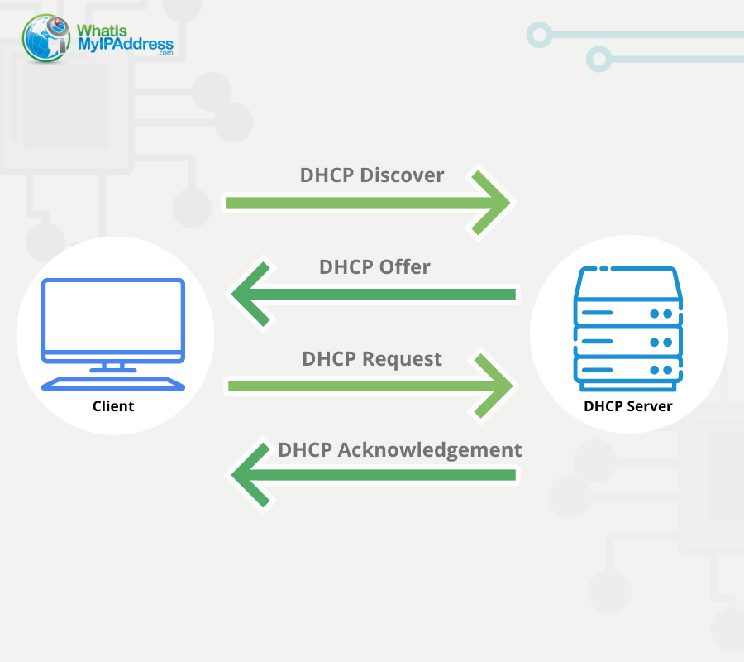
DHCP — Dynamic Host Configuration Protocol
DHCP automatically gives devices network information such as:
IP address
Subnet mask
Default gateway
DNS server
Easy line: DHCP automatically gives an IP address to a device.
How DHCP works?
When you connect your computer or phone
to a network , DHCP automatically
gives it an IP address.
follows 4 steps :
1.Discover 📢 – Device looks for a DHCP server.
2.Offer 📩 – DHCP server offers an IP address.
3.Request 🙋 – Device requests that IP address.
4.Acknowledge ✅ – Server confirms and
assigns the IP.

Slide 14
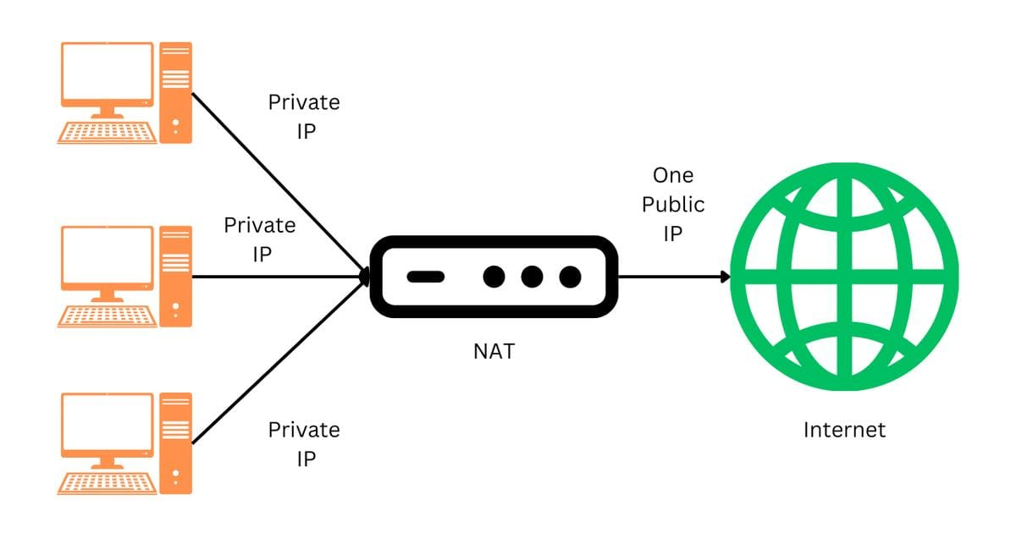
NAT — Network Address Translation
NAT converts private IP addresses into a public IP address when devices access the Internet.
Example: PC (192.168.1.5) → Router/NAT → Internet
Easy line: NAT allows private devices to access the Internet using a public IP.
What NAT does?
Private IP → NAT :The computers send data using their private IP addresses.
NAT changes the address: The NAT router translates the private IP information so the traffic can use one public IP address.
Public IP → Internet 🌐The request goes to the Internet using the public IP.
Response comes back :When the Internet sends a response, the NAT router knows which computer requested it and sends the response to the correct private IP.

Slide 15
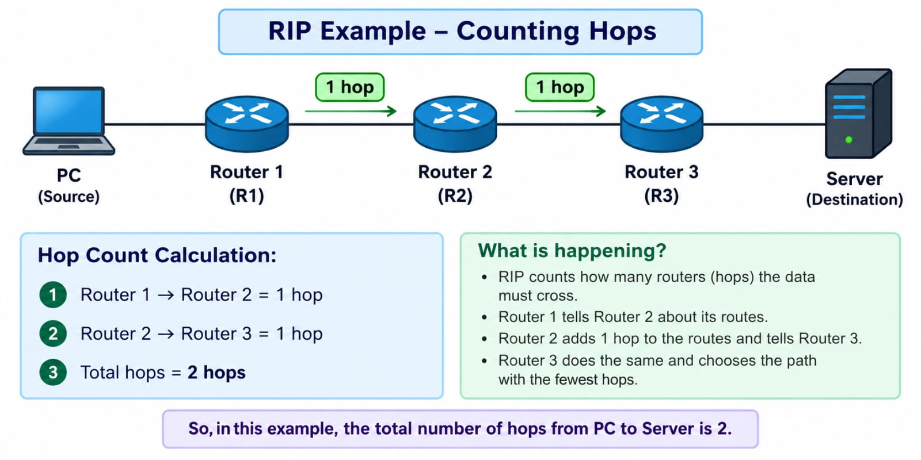
Routing Protocols
RIP — Routing Information Protocol
RIP is a routing protocol used by routers to find the best path for sending data from one network to another.
Easy example: There are 3 routers
PC → Router 1 → Router 2 → Router 3 → Server
RIP counts how many routers (hops) the data must cross.
Router 1 → Router 2 = 1 hop
Router 2 → Router 3 = 1 hop
Total = 2 hops
What is a hop?
A hop is one step from one
router to the next router.

Slide 16
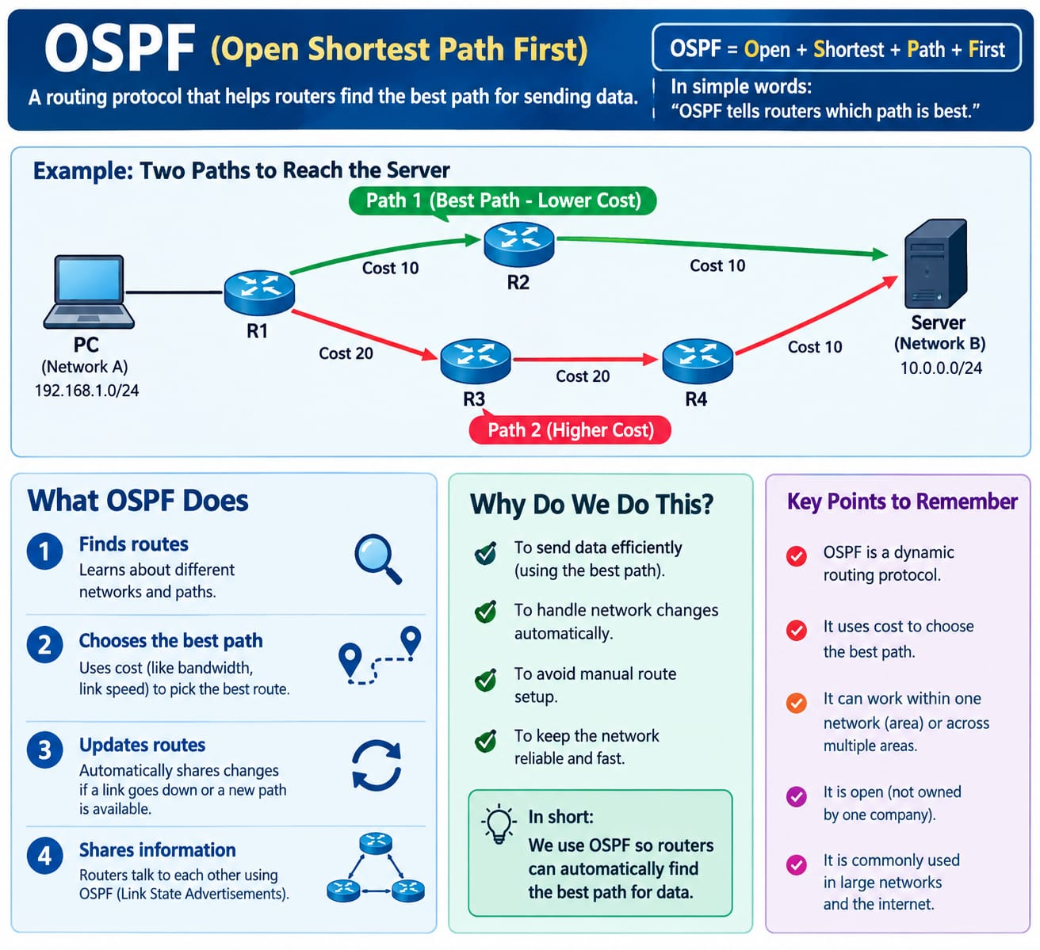
OSPF — Open Shortest Path First
It is a routing protocol used by routers to find the best path for sending data between networks.
Easy meaning:
OSPF = Router finds the shortest/best
path for data.
Why do we use OSPF?
To send data efficiently
To choose the best route
To find a new route if one path fails
To avoid setting every route manually
Easy example
PC → R1 → R2 → Server ✅
PC → R1 → R3 → R4 → Server ❌

Slide 17
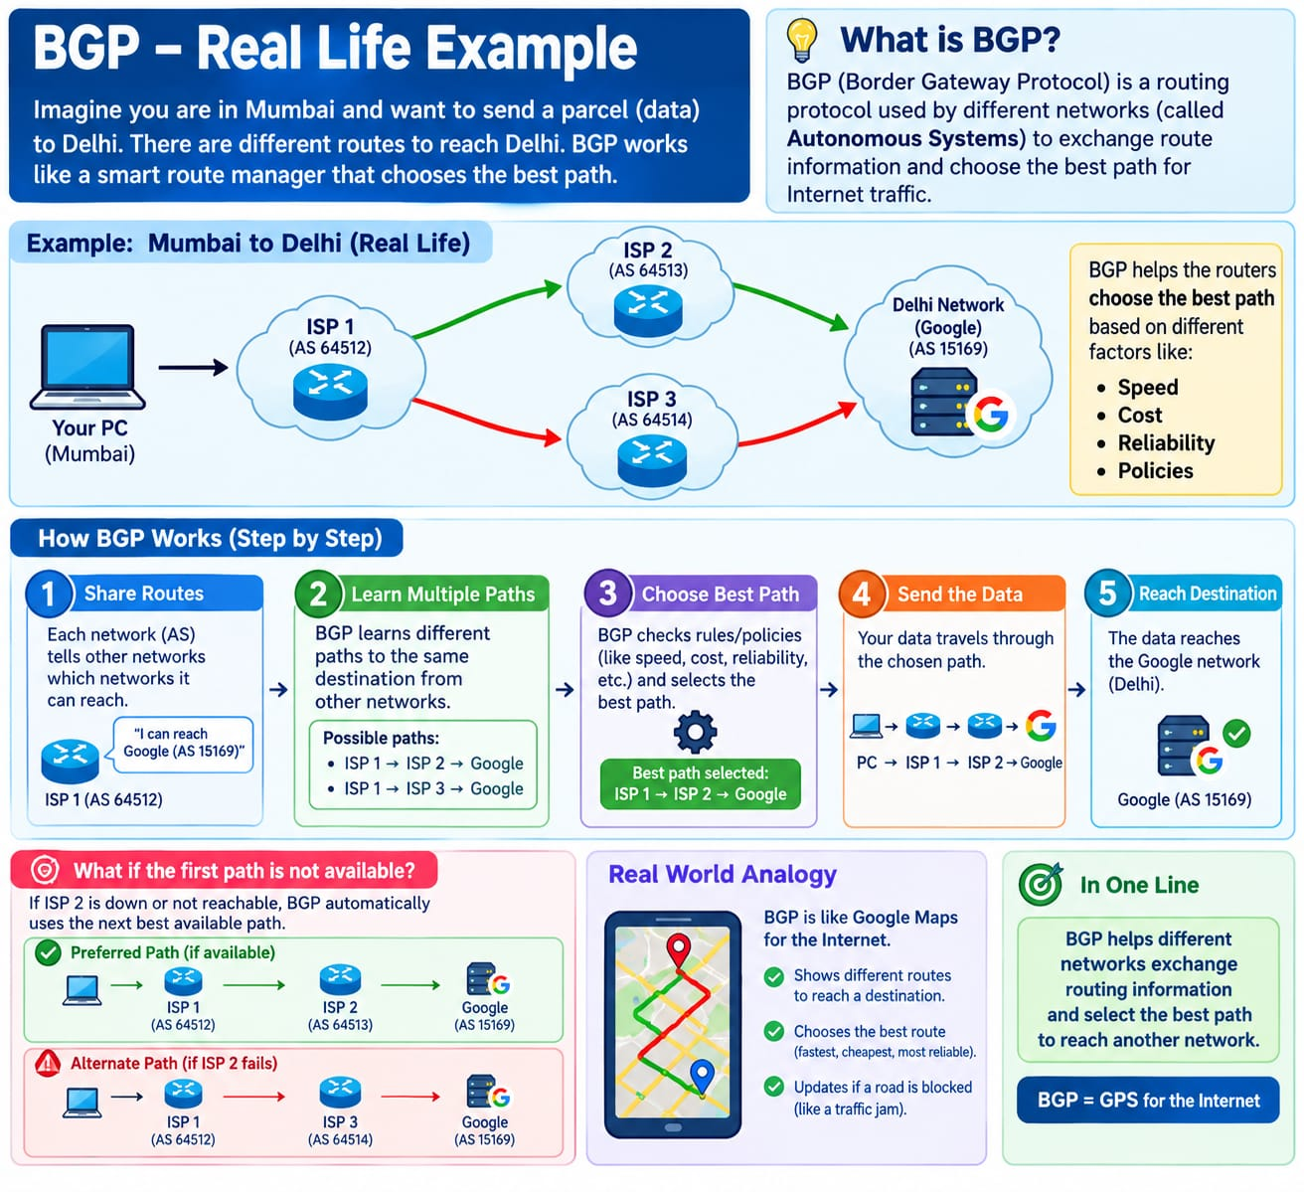
BGP — Border Gateway Protocol
BGP (Border Gateway Protocol) is a routing protocol used to find the best path between different networks on the Internet
Easy real-life example
Imagine you want to go to Mumbai and Google Maps shows 3 roads.
BGP is like Google Maps for networks. It helps routers decide which network path should be used to reach the destination
Why do we use BGP?
Because the Internet has millions of different networks. BGP helps these networks exchange routing inform
For Example:
Your PC
↓
ISP 1
↓
ISP 2
↓
Google.
If the ISP 2 route is unavailable,
BGP can use another available route

Slide 18
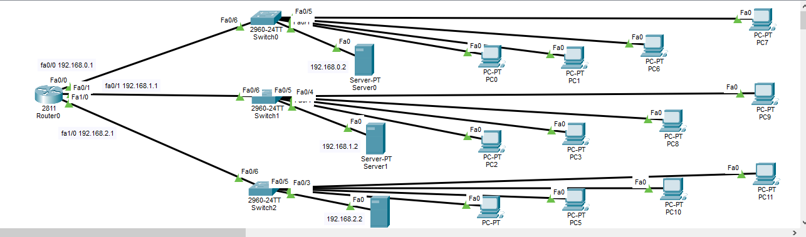
DHCP HHTP DNS configuration in cisco packet tracer

Slide 19
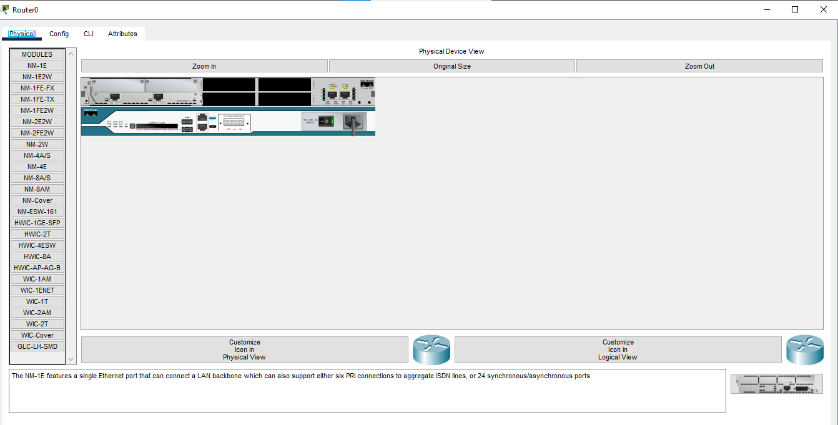
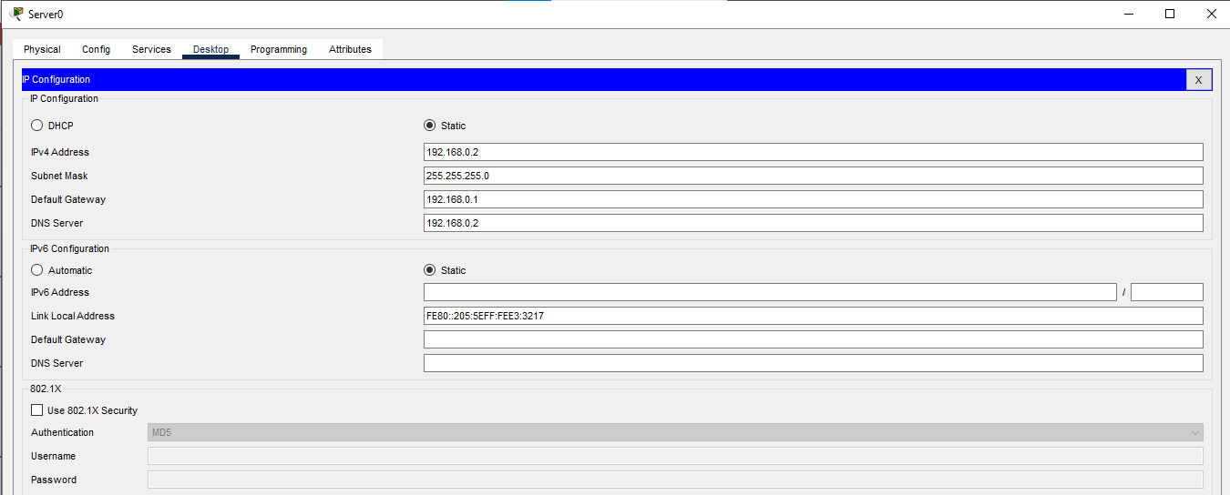
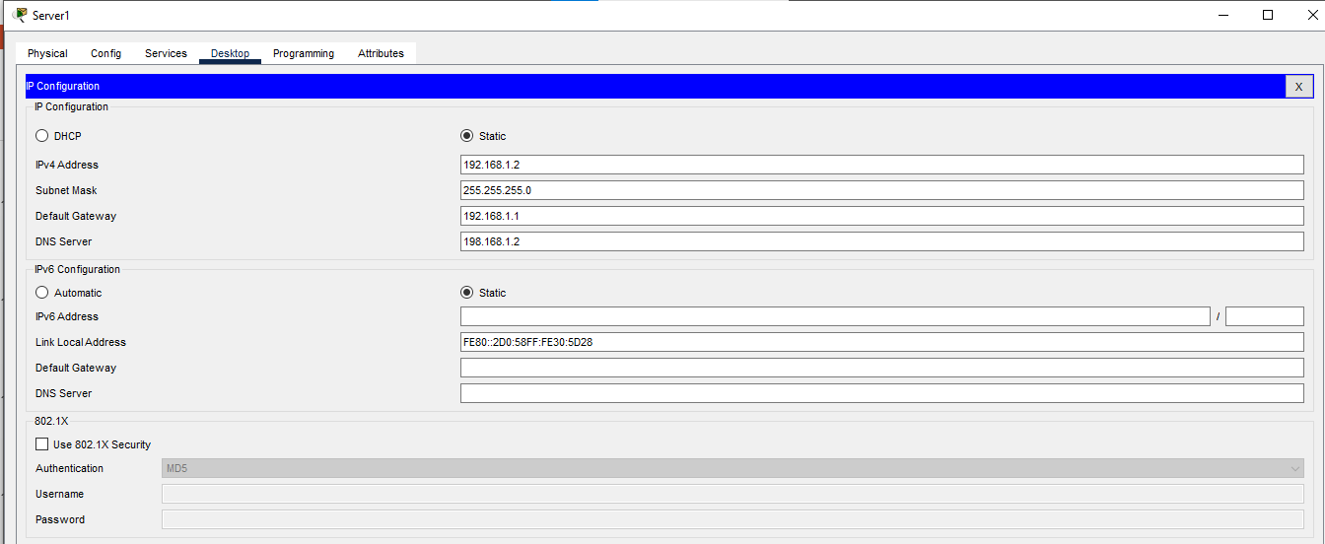
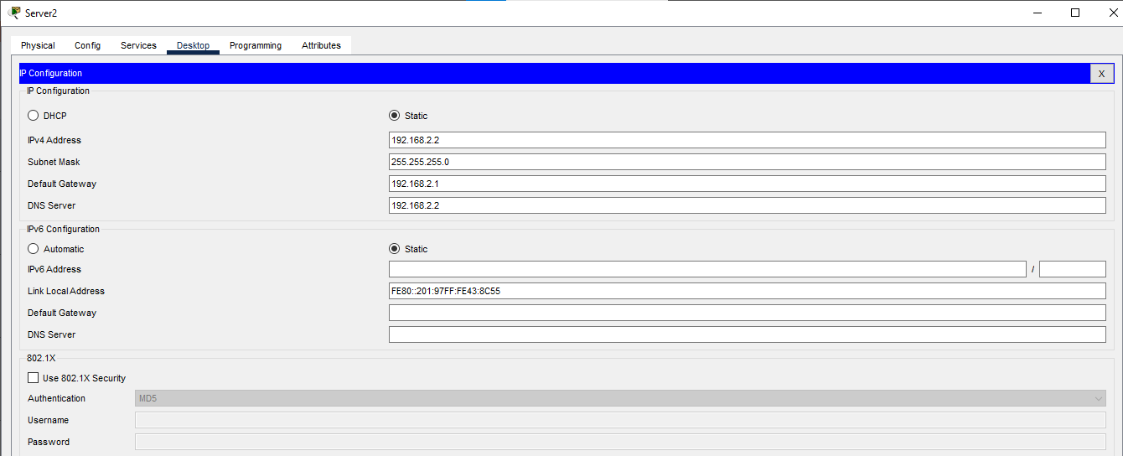
Router server to ip 0 server 1 server 2

Slide 20
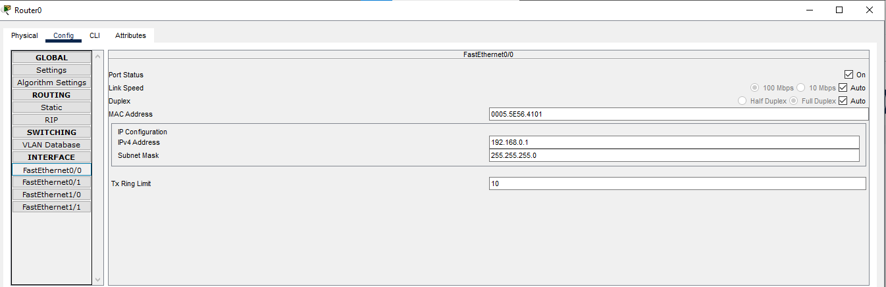
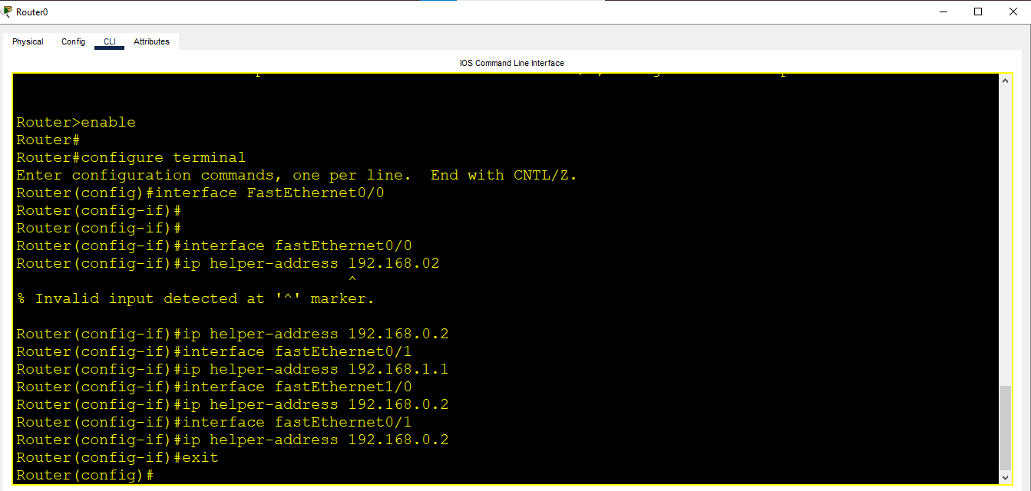
Router IP Configuration
Router

Slide 21


